Slide 1

Office Supply Store Data Analysis
Ben George Samuel
06-01-2020

Slide 2

Overview
Background
Objectives
Methodology
Analysis Results
Recommendations
Appendix

Slide 3
Background
An office supply store tests a telemarketing campaign to its existing business customers.
The company targeted approximately 16,000 customers for the campaign.
The client wants to understand the responses collected in order to maximize the profit in the future campaigns.
The collected information includes:
Customer information such as customer number, number of employees, language preferences
Product information that includes the Computer accessories, Furniture, Stationary products
Historical Data such as historical sales , number of financial transactions

Slide 4

Objectives
Customer Profiling
Build Models to assist future campaigns
Show Financial Value of the Models

Slide 5
Methodology
Extensive Data cleaning of the dataset to remove incomplete data.
Bucketing continuous value attributes such as Historical sales volume
Converting categorical data to dummy variables for better prediction
Using RFE (Recursive Feature Elimination) to find out the most signification factors in the dataset
Creating a Logistic Regression Model to predict if there is a purchase.
Creating a Linear Regression Model to predict the transaction size in the case of a purchase.
Creating Lift chart to describe the profitability of the campaign
Provide Recommendations based on the above findings

Slide 6
Analysis
 | Original Dataset | Data set after the Data treatment
Total number of customers | 16172 | 16165
Attributes | 21 | 68
Categorical | 4 | 0
The most significant attributes in the dataset that assists in predict the purchase :
Tenures ( 25+ years)
Products

Slide 7
Logistic Regression Modeling
Before Modeling
Based on Logistic Regression modelling on 30% of the total data with an accuracy score of 80.8 % ,we were able to produce the below chart.

Slide 8
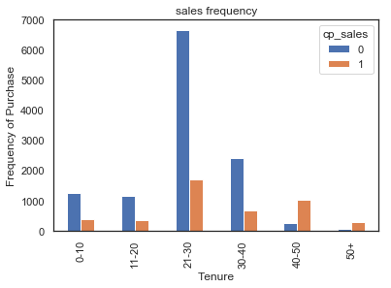
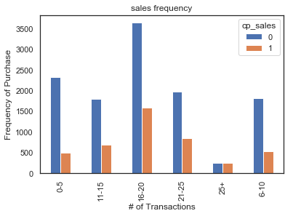
Significant Factors

Slide 9
Financial Prediction
For campaign Sales prediction, we used only the dataset that had made a purchase which is 4378 customers.
Based on Linear Regression modelling on 50% of the data mentioned with an accuracy score of 65% ,we were able to predict the sales made through this campaign.

Slide 10
Lift Chart
Decile | Number of customers | Actual Profitability Per Customer | Lift Over Average | Total Profit | % of Profit | Incr Proj Profit 100K Cust Base ($k) | Total Proj Profit 100K Cust Base ($k) | Cuml Incr Proj Profit 100K Cust Base ($k) | Cuml Total Proj Profit 100K Cust Base ($k)
1 | 809 | 71 | 67 | 57,439 | 157.79 | 670 | 710 | 670 | 710
2 | 808 | 34 | 29 | 27,472 | 75.47 | 290 | 340 | 960 | 1,050
3 | 808 | 21 | 16 | 16,968 | 46.61 | 160 | 210 | 1,120 | 1,360
4 | 808 | 11 | 7 | 8,888 | 24.42 | 70 | 110 | 1,190 | 1,470
5 | 808 | 2 | -2 | 1,616 | 4.44 | -20 | 20 | 1,170 | 1,490
6 | 808 | -6 | -10 | -4,848 | -13.32 | -100 | -60 | 1,070 | 1,430
7 | 808 | -14 | -18 | -11,312 | -31.08 | -180 | -140 | 890 | 1,290
8 | 808 | -20 | -25 | -16,160 | -44.39 | -250 | -200 | 640 | 1,090
9 | 808 | -25 | -30 | -20,200 | -55.49 | -300 | -250 | 340 | 840
10 | 809 | -29 | -34 | -23,461 | -64.45 | -340 | -290 | - | 550
Total | 8K |  | 4.4 | 36,402 | 100

Slide 11
Recommendations
DO’s
Don’t
Concentrate the campaign on the Top 4 Decile to gain maximum profit at minimum cost
Concentrate the campaign on customers who purchase Office supplies.
Recommend Auto-renewal to the customers.
Reach out to new customers (0-10) and to customers with 30-50 years of tenure.
Avoid campaign in non-English speaking countries
Don’t spend on the campaign for customers with 10-30 and 50+ years of tenure.
Do not focus the campaign to companies with more than 50+ employees.

Slide 12
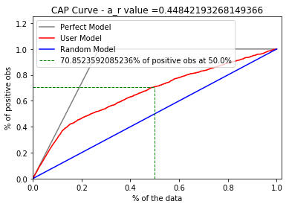
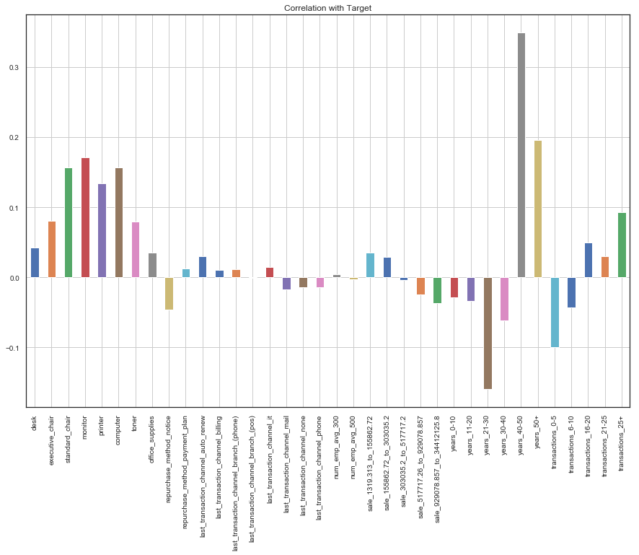
Appendix

Slide 13

Thank You
Email ben10samuel@gmail.com
Phone +974 50068928

